Slide 1
Hygge
A website for chilling

Slide 2
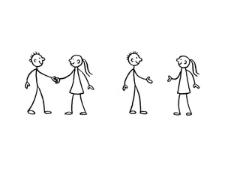
Introductions
Jaskirat
Onisokien
Shrey
https://github.com/ayonoaduo/374Project

Slide 3

Elevator Pitch
What?
How?
Why?

Slide 4

System and Functional Requirements
Simple, fun space for students
“No freaking out about University” zone
Project Vision: A website for students to chill
Project Rationale: Due to the increase in suicide scenarios, we were passionate about mental health.
Envisioned Stakeholders: Any and all Universities wanting to invest in their students

Slide 5
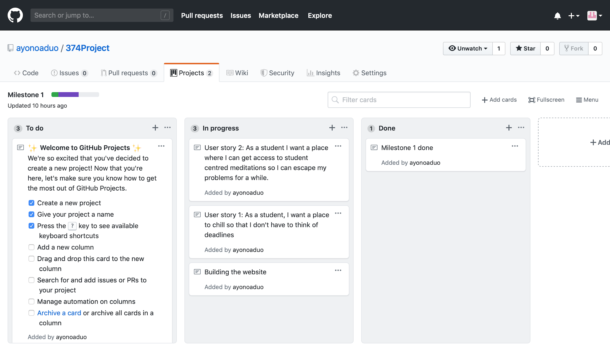
Initial Kanban

Slide 6
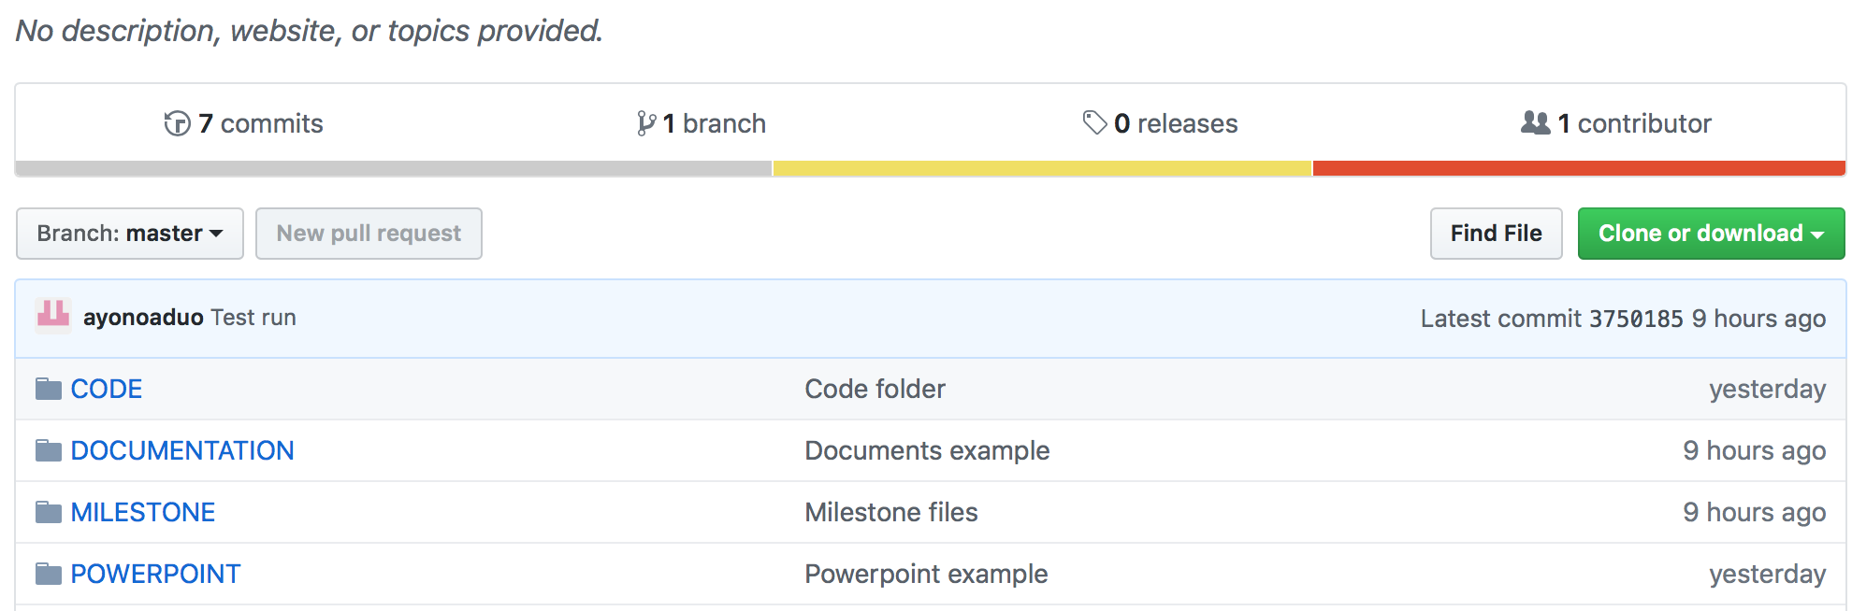

Github

Slide 7

User Stories
As a student I want a place to chill where I don’t have to think about deadlines.
As a student I want a place where I can get access to student centered meditations so I can escape my problems for a while.

Slide 8

Group Reflection
Great for idea generation and organizing the team.
Learnt to play by each other’s strengths.
It’s always great to set up a base for a project.
Currently we don’t have any problems.

